Slide 1
Predicting the Presence of Heart Disease in a Patient
Ashley Schuliger and Shine Lin Thant

Slide 2
Outline
Introduction
Data Preprocessing
Statistical Question #1
Statistical Question #2
Conclusions

Slide 3
Introduction

Slide 4
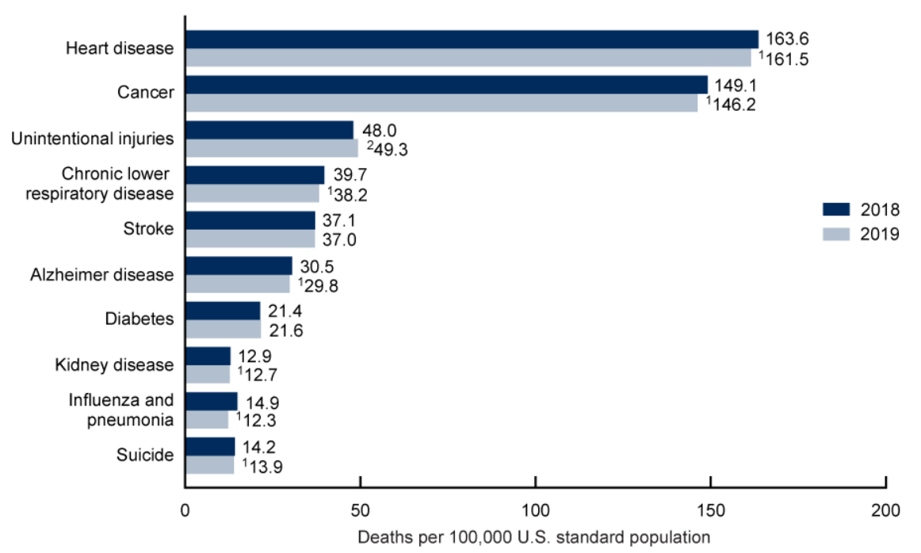
Problem Statement
Heart disease is the leading cause of death in the U.S.
655,000 deaths annually
Diagnosis is challenging
Notes:
https://www.cdc.gov/nchs/products/databriefs/db395.htm
-Heart disease is the leading cause of death in the United States with approximately 655,000 deaths resulting from heart disease each year. Heart disease is a condition that negatively impacts the heart. There are various types of heart disease, such as coronary artery disease, blood vessel disease, and so on. When not treated, these heart diseases can lead to a stroke or worse, a heart attack. Thus, diagnosis of this disease is extremely important. Unfortunately, it is challenging to diagnose heart disease as there are many factors that go into it.

Slide 5
Proposed Solution:
A predictive model to predict whether or not a patient has heart disease and if so, what type
Notes:
-Thus, we propose the solution to build a predictive model that can predict whether or not someone has heart heart disease, and if so, what type of heart disease

Slide 6
Project Justification
Early diagnosis will decrease mortality rates
Specifically, predicting the type of heart disease will allow patients to receive the proper treatment earlier
Provides insights as to the factors that lead to heart disease
Raise awareness for prevention
Notes:
This project is important as it will lead to early diagnosis of heart disease in patients. Early diagnosis allows patients to get the treatment that they need, especially given the type of heart disease that they have, before they have a heart attack.
This project will also provide insights about the important factors that could lead to heart disease. Medical professionals and hospitals can use this information to raise awareness for prevention of thsi disease.

Slide 7
Two Statistical Questions
What factors lead to heart disease?
What factors differentiate one heart disease type diagnosis from another?
Notes:
In our research, we explored two statistical questions:
What factors are important in predicting whether or not a patient has heart disease?
What factors are important in diagnosing the different types of heart disease?

Slide 8
Data Preprocessing

Slide 9
Removing Nulls
Null values negatively impact the performance of models
Ex: Decision trees built with nulls produced a different set of important features
Two options
Remove columns with significant number of nulls
Remove all records with nulls
Notes:
We started preprocessing our data by removing null values. In our case, null values include NA’s, empty strings for qualitative features, and 0 for numerical features with higher ranges.
Nulls needed to be removed from the dataset as they can negatively impact the results of our models. For example, as you will see in the following slides, we attempted to use decision trees, but the important features that were used to build our trees differed significantly depending on if we used a dataset with nulls or not.
When we analyzed our dataset, we noticed that were about 5 features that included a significant number of null values (approximately 60% of the dataset). As a result, we tested out two ways of removing nulls. Our first option was to remove these troublesome columns in order to reduce dimensionality and keep our large dataset. However, this option could lead to decreased accuracy if those features we important in identifying heart disease within a patient. Our second option was to remove any records that contained null values. However, doing this would result in a dataset with a significantly reduced volume. A small dataset can be difficult to train as models are more likely to overfit on the data due to the curse of dimensionality.
In the following slides, we will show the difference between these two null removal strategies on our decision tree models, and explain our choice for the rest of our analyses.

Slide 10
Data Distribution
Split dataset to create more balanced classes for analysis
Two ways of splitting the data:
0 (no heart disease) and 1 (heart disease)
1, 2, 3, 4 (differing types of heart disease)
Notes:
Next, we split the dataset based on our response variable to have more balanced classes for our model. So our response variable has 5 different classes in total, which is 0,1,2,3, and 4. And during our analysis, we split the data 2 ways. First we filter our dataset so that it contains only 0s and 1s for our predictive model. Then, we remove 0s from the dataset and leave only 1,2,3,4 for our interpretable analysis. 0 means a patient does not have heart disease, and 1 means they have heart disease. And then from there, if they have heart disease, there’s four different types corresponding to the severity of the disease, 1 being the least severe to 4 being the most severe.

Slide 11
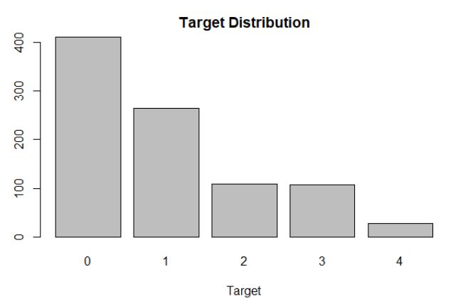
Balancing the dataset
Reduces bias
Improves the integrity of the accuracy
Notes:
Next, we balanced the dataset to have an even distribution of classes in our data and to reduce bias in our results. You can see this distribution in the bar chart here. As you can see, the distribution between classes is highly unbalanced. There are a lot of 0s and 1s, but very few 3s and 4s, which is why we balanced the data so that we can guarantee better integrity of our results.

Slide 12
Dummy Variables
Improves the performance of linear regression methods
Qualitative variables:
Sex
Chest pain type
Fasting blood sugar > 120mg/dl
Exercise induced angina
Slope of peak exercise ST segment
Thallium test results
Notes:
We also needed to convert some of our features into dummy variables. Dummy variables are important in increasing the accuracy of regression models such as logistic regression and linear regression as they remove the hierarchical property in place when using numbers to label qualitative variables.

Slide 13
Statistical Question #1:
Can we predict whether or not a patient has heart disease?

Slide 14
Attempt #1: Decision Trees
Interpretable model
Allows us to analyze factors for heart disease
Complements classification applications
Performs well with non-linearly related features

Slide 15
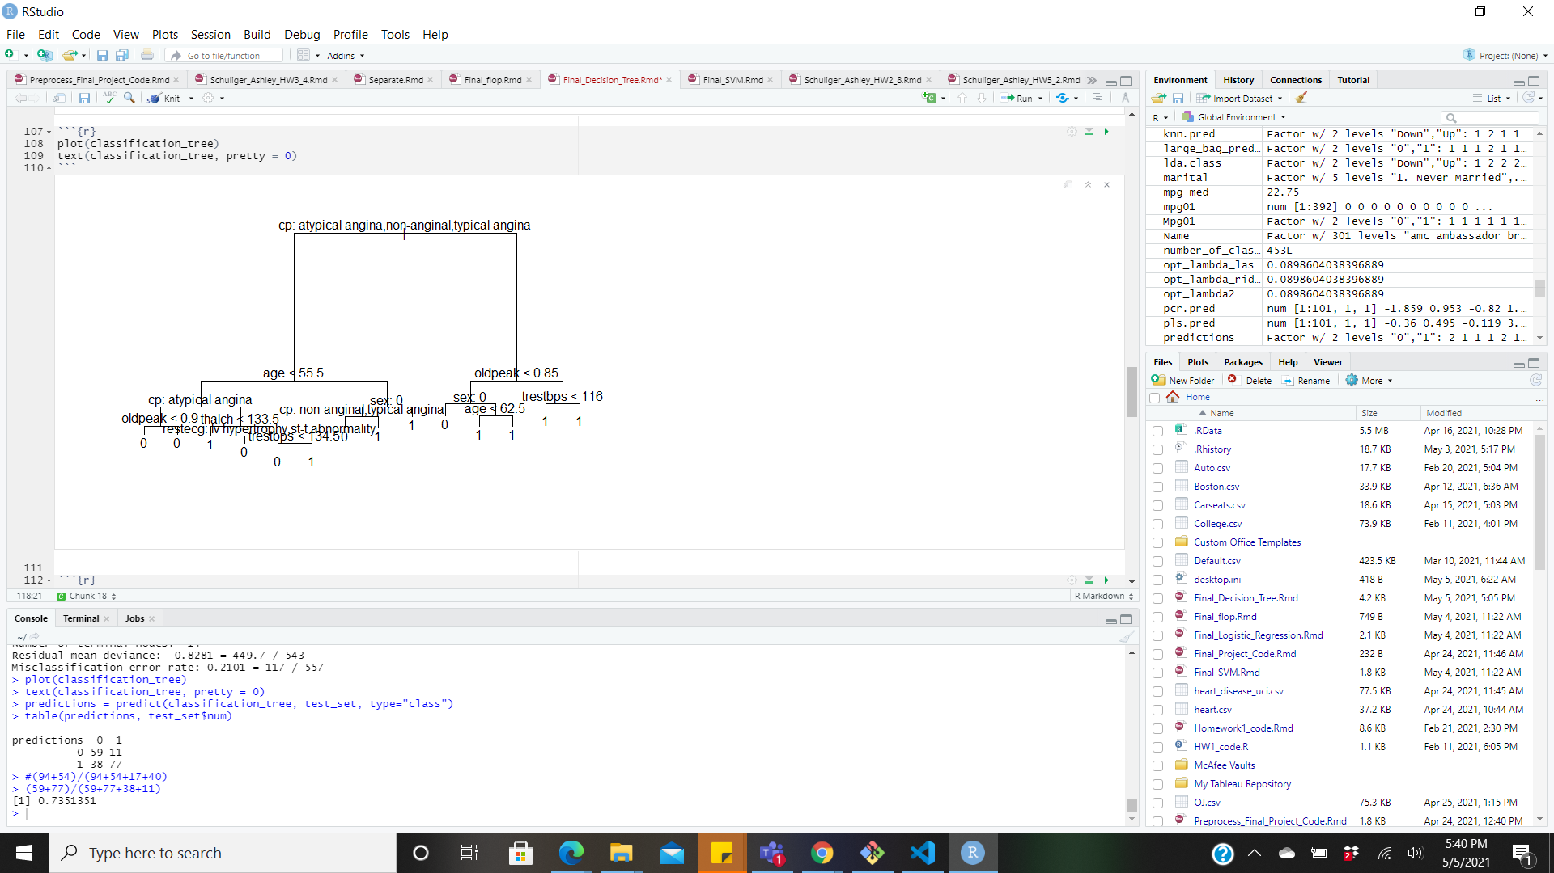
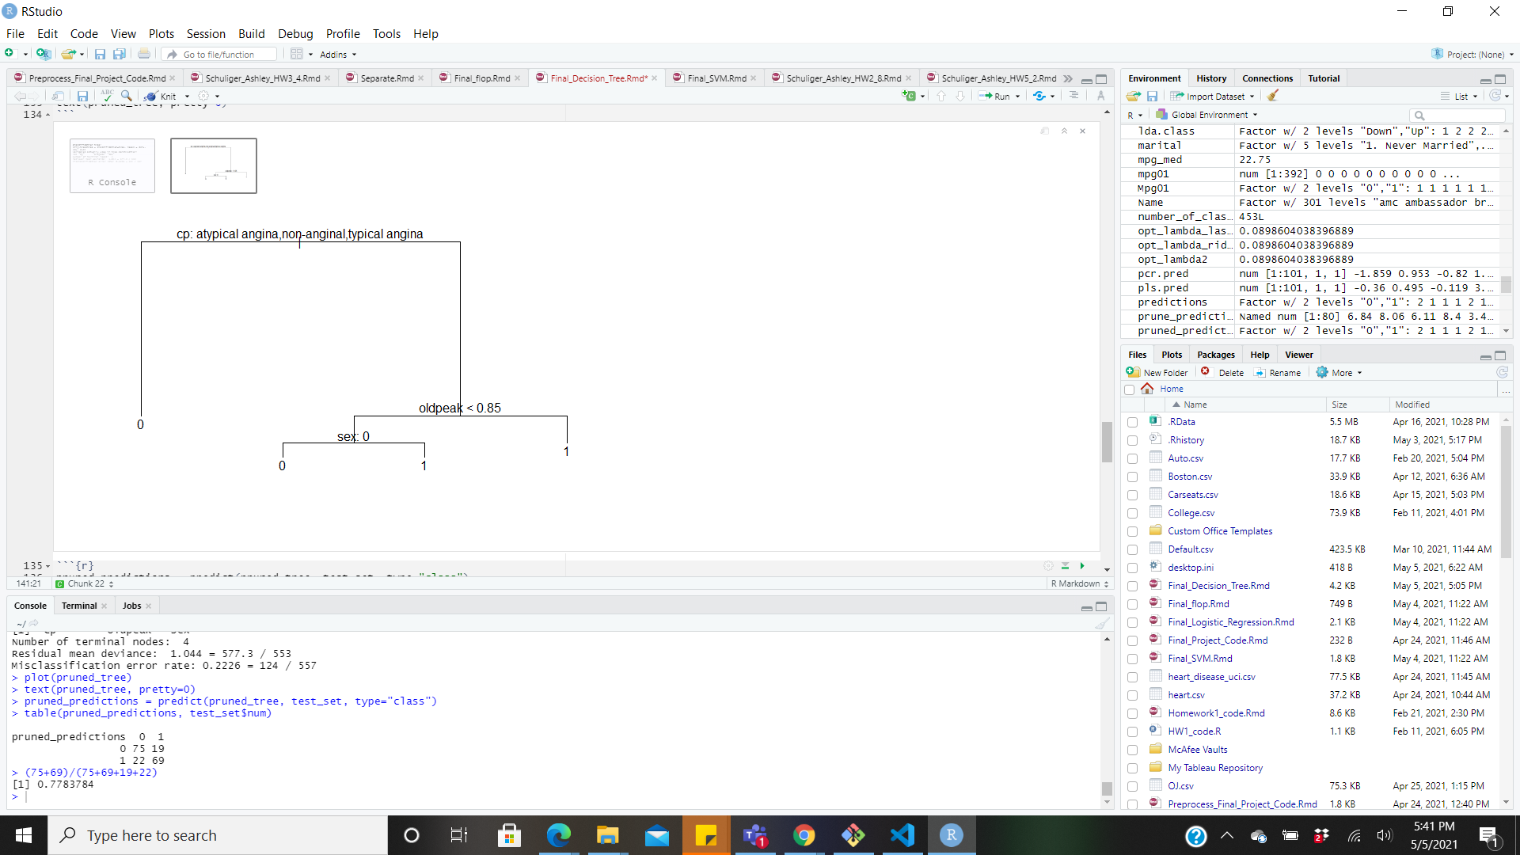
Decision Trees (w/out null columns)
Initial classification tree accuracy
Train: 78.99%
Test: 73.51%
Pruned tree (4 nodes) accuracy
Train: 77.74%
Test: 77.84%

Slide 16
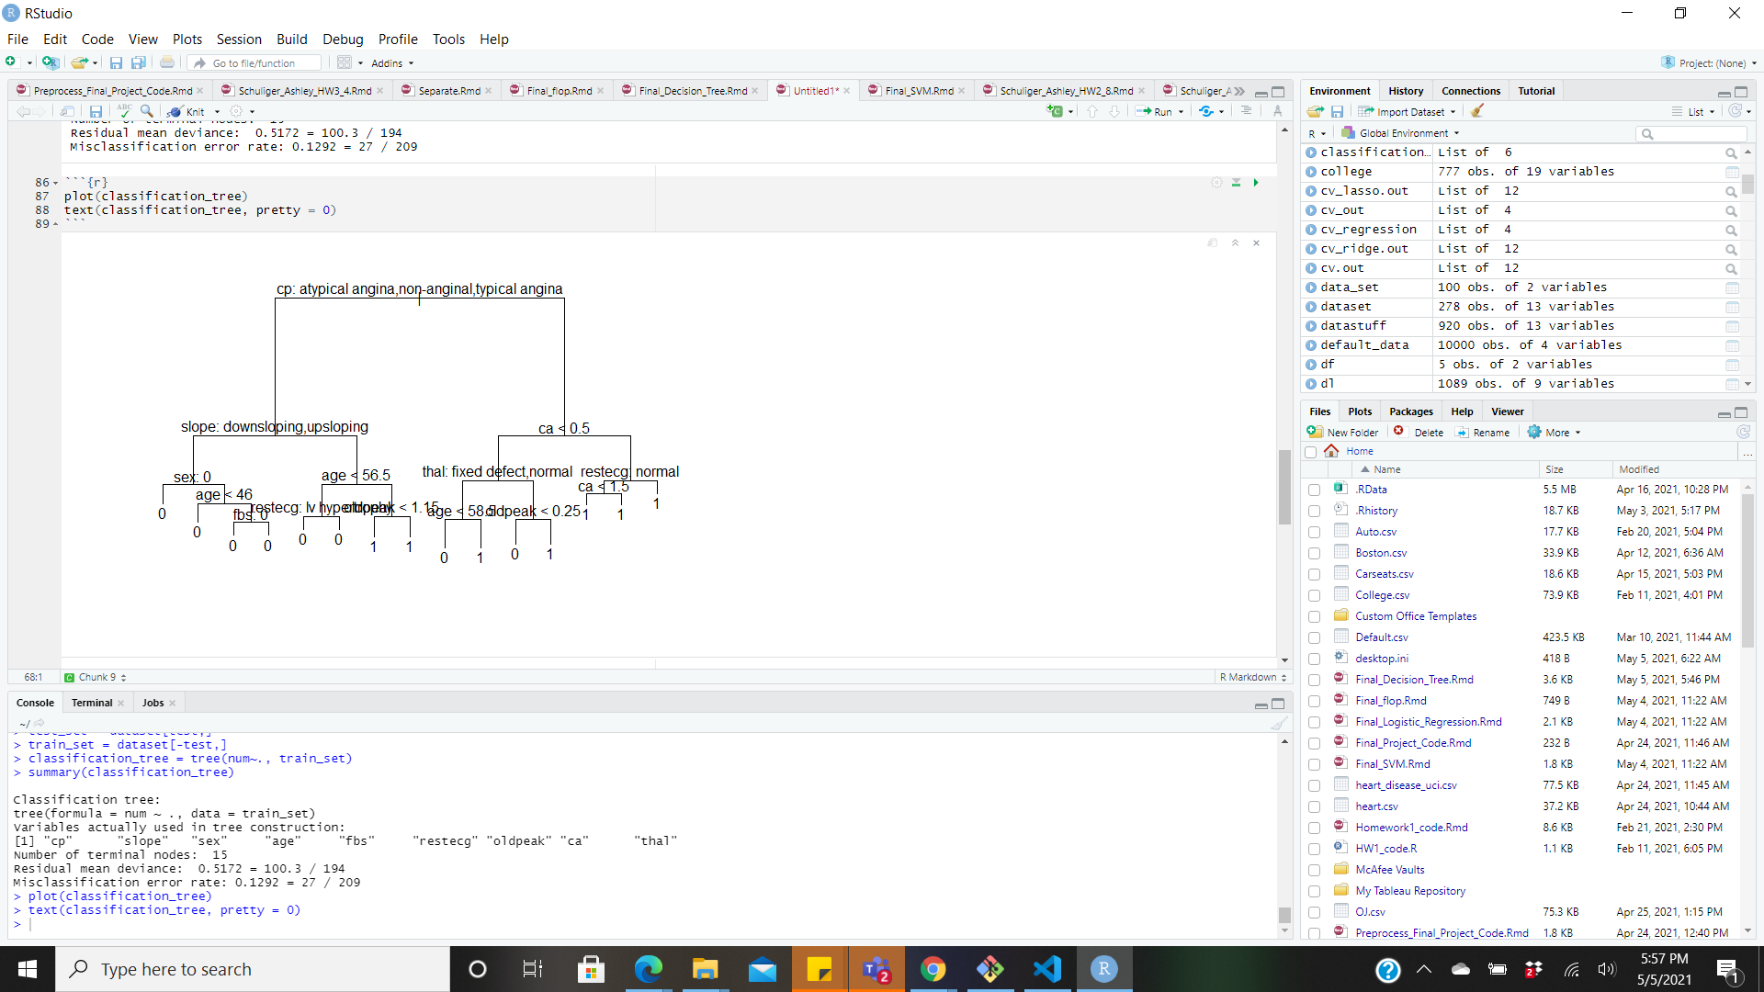
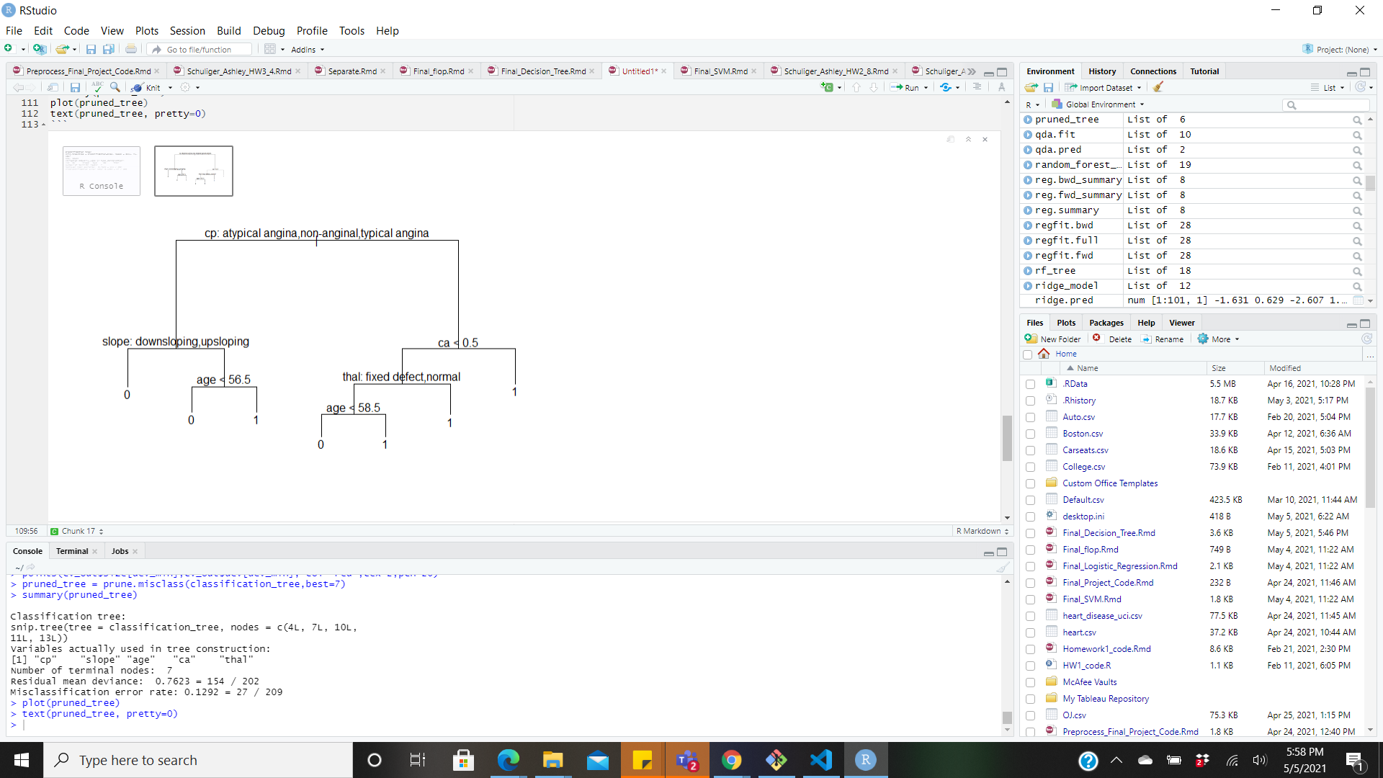
Decision Trees (without null values)
Initial classification tree accuracy
Train: 87.08%
Test: 79.71%
Pruned tree (4 nodes) accuracy
Train: 87.92%
Test: 79.71%

Slide 17
Attempt #2: Bagging
Goal: Decrease the variance of our model
Thus, increasing the accuracy of our model
Crucial for datasets with a high dimensionality and low cardinality
I.e. our dataset with null values removed

Slide 18
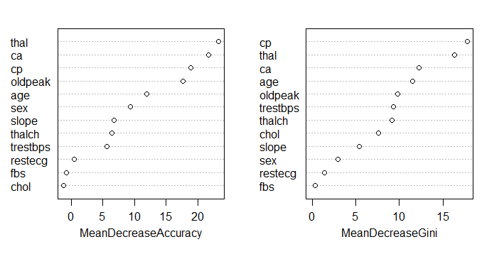
Bagging
Accuracies
OOB: 77.03%
Test: 82.61%
Significant Features:
Chest Pain
Thallium test result
Number of major vessels
Oldpeak
Age

Slide 19
Attempt #3: Random Forests
Improves bagging by decorrelating trees
Builds trees on varying subsets of features
Results:
OOB accuracy: 79.43%
Test accuracy: 85.51%

Slide 20
Attempt #4: Logistic Regression
Performs well on linearly related data
Comparison to the performance of our decision trees
Experimented with all predictors and a selected set of features
Features were chosen from the significant features reported in bagging
I.e. Thallium test result, chest pain, oldpeak, number of major vessels, and age

Slide 21
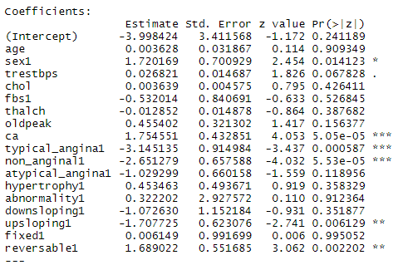
Logistic Regression (all predictors)
Accuracies
Train: 86.67%
Test: 81.43%
Significant features:
Number of major vessels
Typical angina and non_anginal chest pain

Slide 22
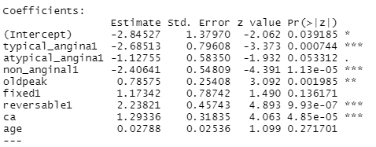
Logistic Regression (select features)
Accuracies
Train: 84.77%
Test: 78.57%
Significant features:
Number of major vessels
Typical angina and non_anginal chest pain
Reversible effect

Slide 23
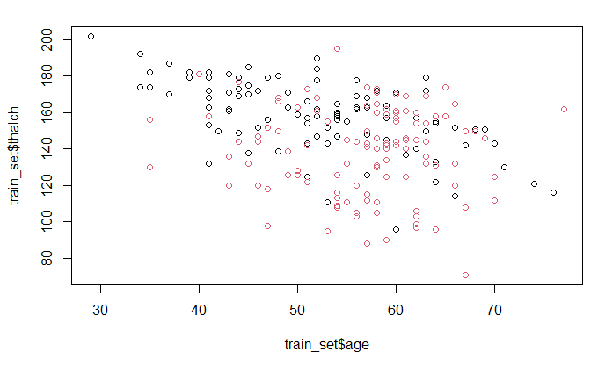
Attempt #5: Support Vector Machine
Performs well in binary classification applications with two separable features
Can be linearly or nonlinearly separable
Experimented with the relationship between age and thalch (max heart rate)

Slide 24
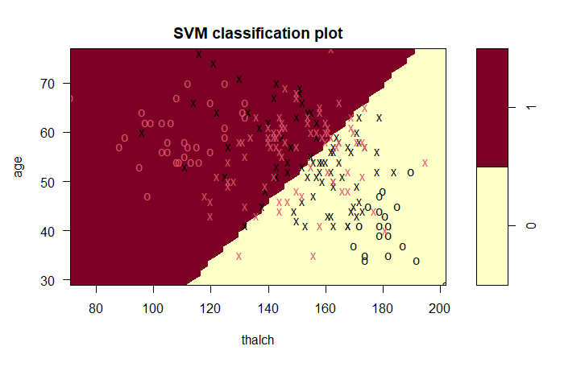
Support Vector Classifier
Accuracies
Train: 70.14%
Test: 68.12%

Slide 25
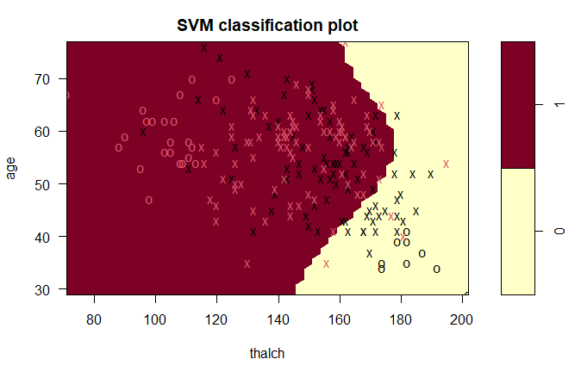
Support Vector Machine: Polynomial
Accuracies
Train: 65.07%
Test: 55.07%

Slide 26
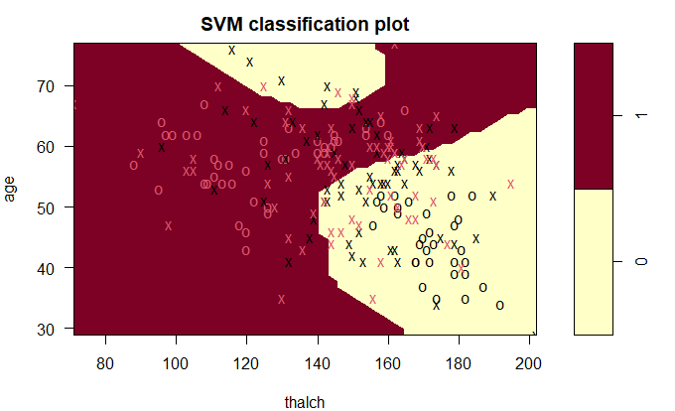
Support Vector Machine: Radial
Accuracies
Train: 75.6%
Test: 73.9%

Slide 27
Best Approach
For prediction, our chosen model is the Random Forest model with a test accuracy of 85.51%
For interpretation, our chosen model is the Logistic Regression model with a test accuracy of 81.43%

Slide 28
Statistical Question #2:
What factors cause different types of heart disease?
Notes:
So our next statistical question we aim to answer is what factors contribute to each type of heart disease?

Slide 29
Pruned Feature Set
Predictors from Random Forest:
Number of major vessels
Oldpeak
Thallium test result
Reversable
Notes:
First we ran a Random Forest model to examine which variables are significant in the entire dataset, and we found that these are the four most significant variables.

Slide 30
Attempt #1: LDA and QDA
Predict different types of heart disease
LDA vs QDA
Classification Problem
Notes:
And so using the variables we got from the Random Forest, we built LDA and QDA models to classify different types of heart disease. We chose LDA and QDA because we have more than 2 classes in our response variable and we know that LDA and QDA are suitable for our purpose and work well when dealing with classi.

Slide 31
Results: LDA & QDA
LDA test accuracy
50%
QDA test accuracy
42%
Notes:
So these are the results from our LDA and QDA analysis, we achieved 50% test accuracy for LDA and 42% accuracy for QDA, so we found that LDA performed better than QDA for our case. However, as the numbers suggest, these are not overwhelming results. So next, we moved on to Logistic Regression.

Slide 32
Attempt #2: Logistic Regression
Goal: Build an interpretable model that identifies important factors in the differing classes of heart disease
Performed logistic regression on different subsets of the heart disease classes versus healthy patients
I.e. Classifying 0 versus 1, 0 versus 2, etc.
Notes:
In answering the second part of our question, we wanted to identify for each type of heart disease, exactly which variables are the most significant so we ran logistic regression on different subsets of the heart disease against healthy patients. So we ran Logistic regression on 0 vs 1, 0 vs 2, 0 vs 3 and so on. And we also looked at mild vs severe classification to further understand what differentiates a mild vs a severe case of the disease.

Slide 33
Significant Variables
For mild cases
Case 1: Ca, Thalch, Reversible
Case 2: Ca, Oldpeak, Thalch, Reversible
For severe cases
Case 3: Ca, Thalch, Reversible
Case 4: Ca, Oldpeak, Reversible
Mild vs Severe (Case 1 vs Case 4)
Ca, Oldpeak
Notes:
And these are the results that we got from our various Logistic Regression models. We found that for all of the cases, there are two variables that are always very significant, while the significance of the rest alternate across different cases.
Ca: the number of major vessels showed up during fluoroscopy
Thalch: maximum heart rate achieved during thallium test
Reversible: when someone has a thallium test result that suggests a blood disorder where blood doesn’t circulate in a region of the body during rest but DOES during exercise
Oldpeak: the amount of ST depression seen as the beginning of an ecg graph

Slide 34
Best Approach
Logistic Regression Analysis (Interpretation)
Determine important predictors
Analyzing each type of heart disease
Notes:
Overall, we discovered that Logistic Regression is the best approach for interpretation as we were able to get a clear picture in determining and understanding what factors cause different types of heart disease.

Slide 35
Conclusions

Slide 36
Conclusions
Random Forest model is the best approach for predicting heart disease
Logistic regression can uncover important features in differentiating between types of heart disease
Notes:
In conclusion, we based on our experiments and results, we found that a Random Forest model is the best model for predicting whether or not a patient has heart disease.
We also found that through logistic regression, we can identify the important features used

